Slide 1


Slide 2
CSC 236
Tutorial Number 8 - Daniel Razavi

Slide 3
How was the midterm?

Slide 4


Slide 5
Today’s Problem Set

Slide 6
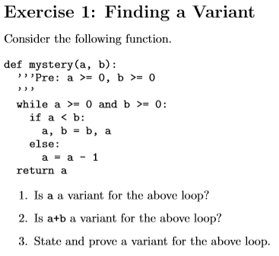

Slide 7
1. No: “a” doesn't decrease in the 'if' branch, “a” increases there.

Slide 8
2. No again: a+b doesn't decrease in the 'if' branch.
a+b stays equal after the swap.

Slide 9
3. In the 'else' branch, “a” decreases, so “a” should probably be part of this.
In the 'if' branch, we know that the larger value is “b”, and that “b” decreases after the swap.
The variant should therefore include something that gives more "weight" to “b”, so that this increased weight drags the invariant down after the swap. Here's one:
2b+a why?

Slide 10
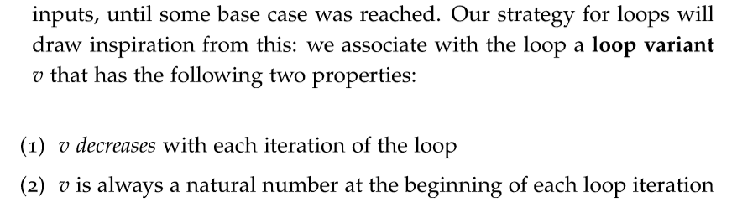
Notes.pdf page 59
2b+a Here is why!
First, we need to prove that the variant decreases on each loop iteration
There are two cases to consider here. The “else” case is simpler, so let's do that one first. In that branch, a decreases by 1, so 2b+a decreases by 1.

Slide 11
2b+a Here is why!
Notes.pdf page 59
Now for the “if” case, where “a” and “b” are swapped.
Before the loop iteration, we have values a_0, b_0, and m_0 = 2b_0+a_0; also, by the if-statement, we have a_0 < b_0.
After the iteration, we have a_1 = b_0, b_1 = a_0, and m_1 = 2b_1+a_1 = 2a_0+b_0. We must show that 2a_0+b_0 < 2b_0+a_0.
This is equivalent to proving that
a_0 < b_0
which is exactly what we know to be true by virtue of the if-condition being true.
Therefore, our variant is valid for the loop, and we conclude that the loop terminates.

Slide 12
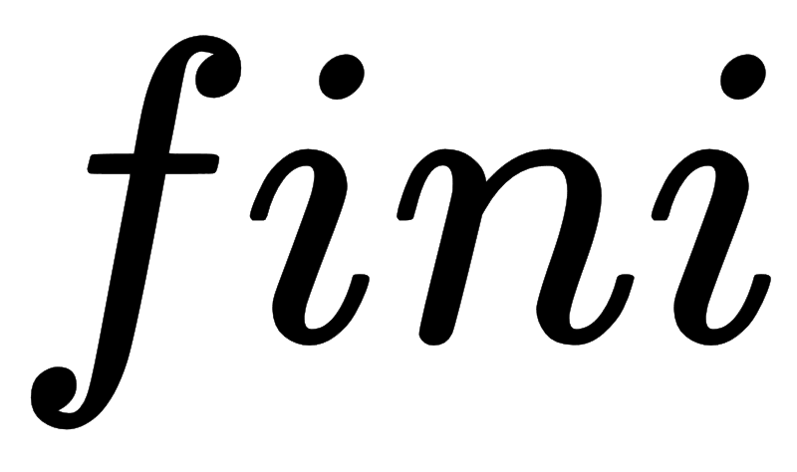
Notes.pdf page 59
2b+a Here is why!
Secondly, we need to prove that the variant is part of the natural number.
By the loop-condition, we have that a >= 0 and b >= 0. Therefore, 2b+a >= 0.

Slide 13
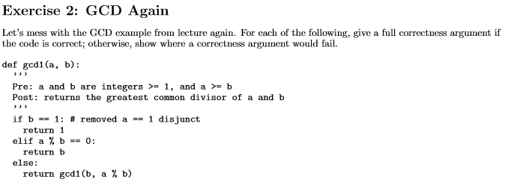

Slide 14
gcd1: this is still correct.
When a == 1, the precondition forces b to be 1, so it's unnecessary to check that a == 1 here too.
Notes:
(One other thing to consider: what happens if we remove the a >= b precondition? Is the code still correct? It is! Even without the a == 1 in there.)

Slide 15
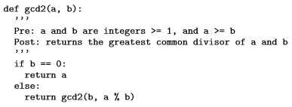

Slide 16
gcd2: this one might "return the correct answer", but a correctness proof will fail because we can make a recursive call that violates the precondition;
e.g. gcd2(8, 4) calls gcd2(4, 0), and we don't know what happens when a value of 0 is supplied for b. To give a proof of correctness, we would have to change the precondition to allow a and b to be integers >= 0.

Slide 17
CSC 236
Tutorial Number 8 - Daniel Razavi

